Slide 1
UDK Game Development
11/2012
EVROPSKÝ SOCIÁLNÍ FOND
Lecture 3 – Custom model and animations
PRAHA & EU INVESTUJEME DO VAŠÍ BUDOUCNOSTI
Michal Bída
michal.bida@gmail.com
Charles University in Prague
Faculty of Mathematics and Physics

Slide 2
Step One – 3D Max
UDK has ActorX plugin for 3D Max 2010 and 2011
Enables to export MAX models and animations to UDK
ActorX
Has “features”, but usable ☺
Before exporting animations you need to export the model first (ActorX will store the mesh and bone data)
When you want to export anims for a different model you need to export the new model again before you start to export animations (ActorX will update its current mesh and bone data with new model)

Slide 3
Step Two - UDK
Understands .psk and .psa files got by ActorX
Currently it is not possible to change the Mesh size in UDK! You need to change this in 3D Max (and re-import)!

Slide 4
Workflow
Use 3D Max to create model, animation
Import model, animations, textures to UDK packages
Create materials, associate textures, animations with model
Create Animation Tree using the animations
Create custom Pawn class using new model, animations and animation tree
(Optional) Create new Controller class
Configure Game class to use new Controller class and new Pawn class

Slide 5
Let’s switch to UDK
Before Compiling!
Make sure your mod is listed in EditPackages in UDKEngine.ini at the end (last EditPackages)!

Slide 6
Online materials, tutorials
http://pogamut.cuni.cz/pogamut-devel/doku.php?id=lectures
http://udn.epicgames.com
contains many tutorials and guidelines and is constantly updated
http://www.youtube.com/user/UnrealDevelopmentKit
is a great resource of UDK oriented video tutorials
http://forums.epicgames.com/
contains thousands of user and developers interested in Unreal development
http://forums.beyondunreal.com
is another great community site about UDK development
http://wiki.beyondunreal.com
is a long maintained wiki that is constantly updated (however for UDK development it is not as good as for UT2004)

Slide 7
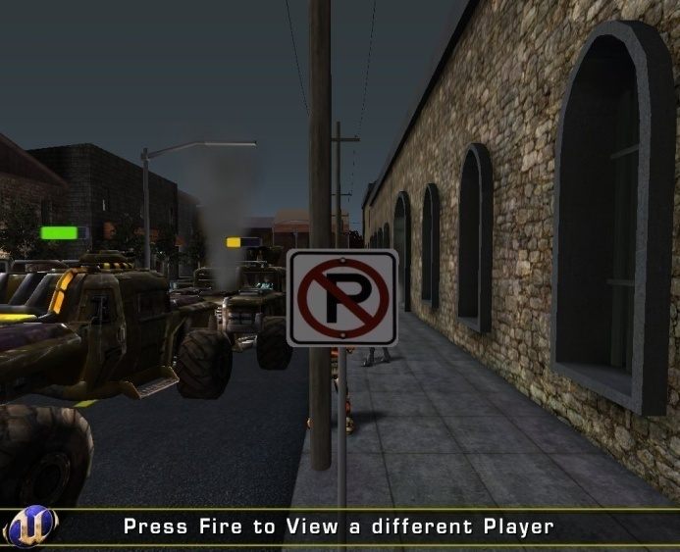
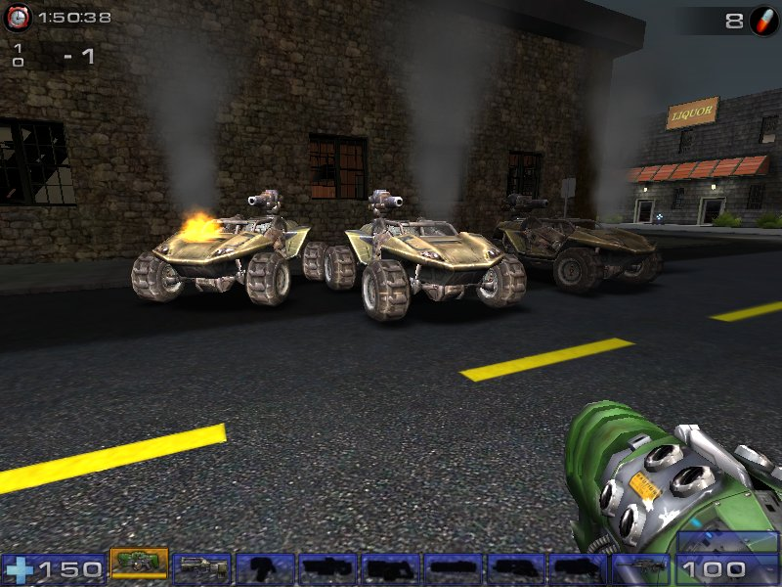
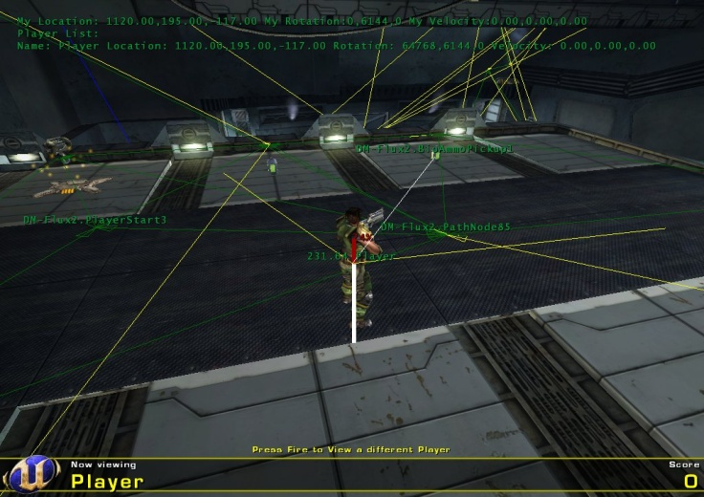
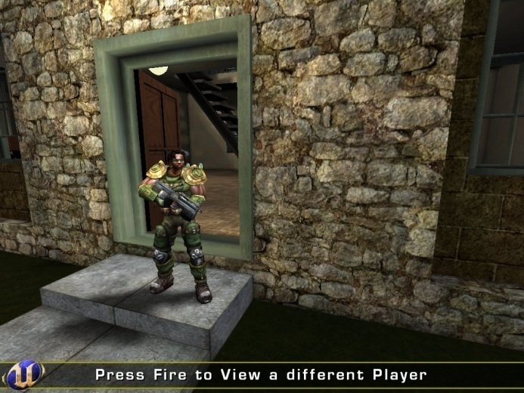
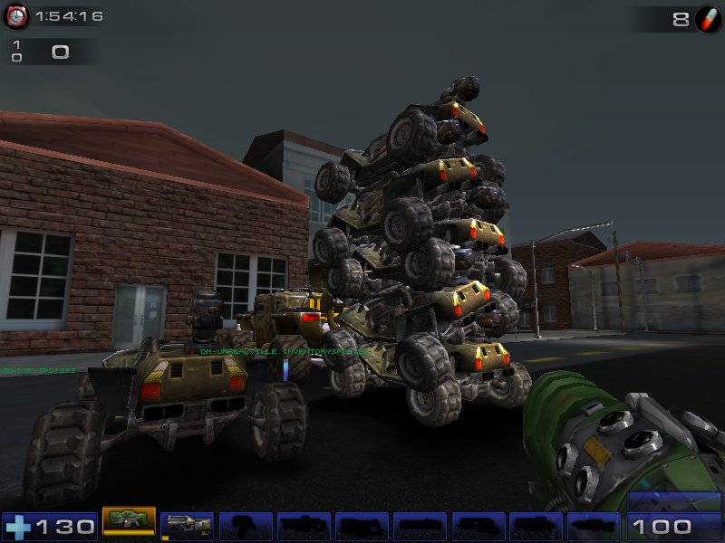
The end.
Questions?
http://pogamut.cuni.cz/pogamut-devel/doku.php?id=lectures

Slide 8
EVROPSKÝ SOCIÁLNÍ FOND
DĚKUJI ZA POZORNOST

